Slide 1
Dsi final presentation: exploring hospital respiratory illness outbreaks
Gabriela Osorio
Bitmaker data science immersive
Final presentation
December 14, 2018

Slide 2
Quick agenda
Intro to data science
Research methodology
Moving ahead
Lessons learned

Slide 3

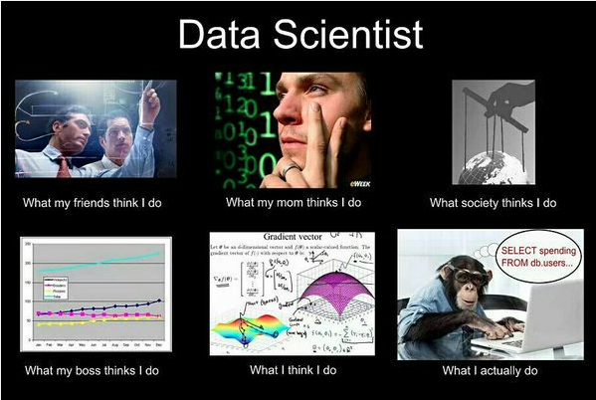

Slide 4
“Data science…
That’s like numbers and stuff, YeaH?”
- You, possibly
Yeah!
But also…nah.

Slide 5
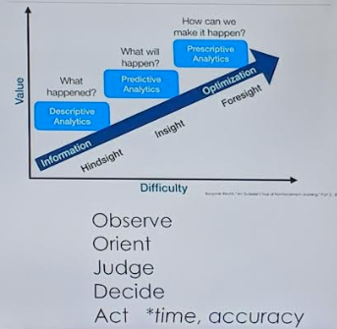
Applications
Research
  Visualizations
  Insights
  Predictions
Product development
  Chatbots
  Automated processing of internal operations
  Optimizing components of produce
Sports analytics
  Baseball batting average

Slide 6
Method:
Orientation/Pre-Processing
Clean the dataset
Orientation
Decide on your question/predictor
Modeling
Split your data into X and y
Split the dataset into train and test sets
Train, test, score the data on a baseline model
Train the train data set on an algorithm/model (or many)
Test and score the train dataset on your model
Tweak model as necessary
91%
9%
Time spent coding vs time spent modeling

Slide 7
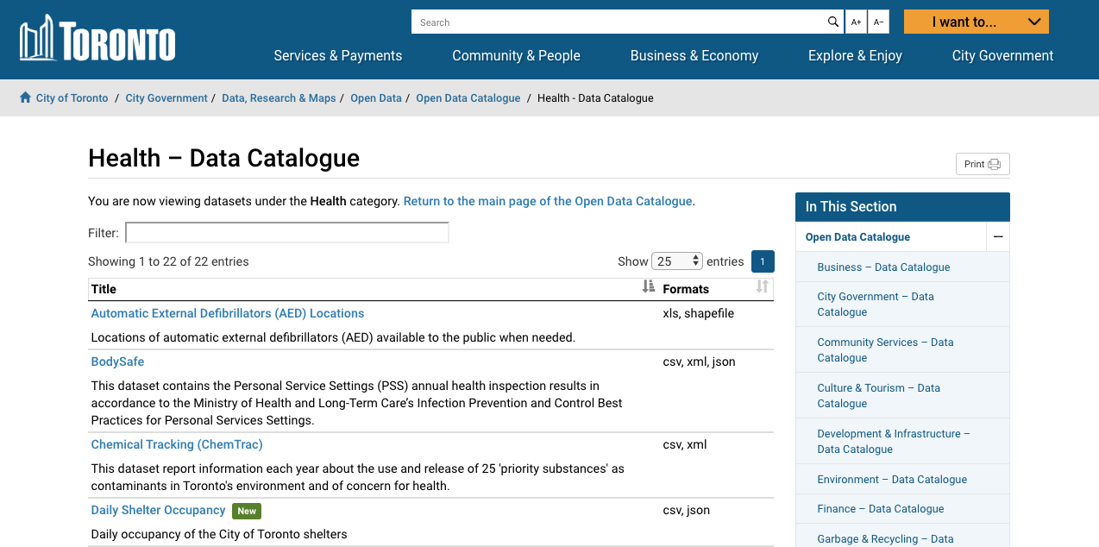
Toronto’s Open Data Project

Slide 8
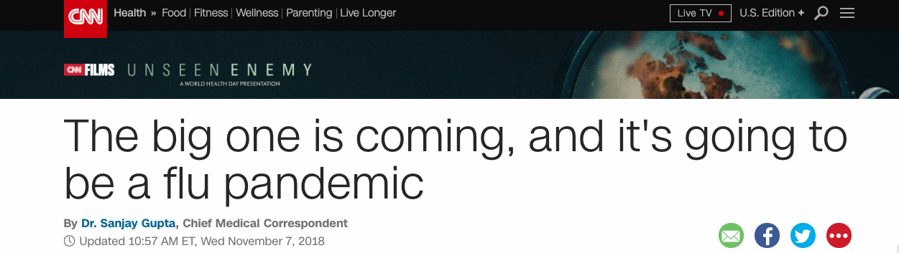
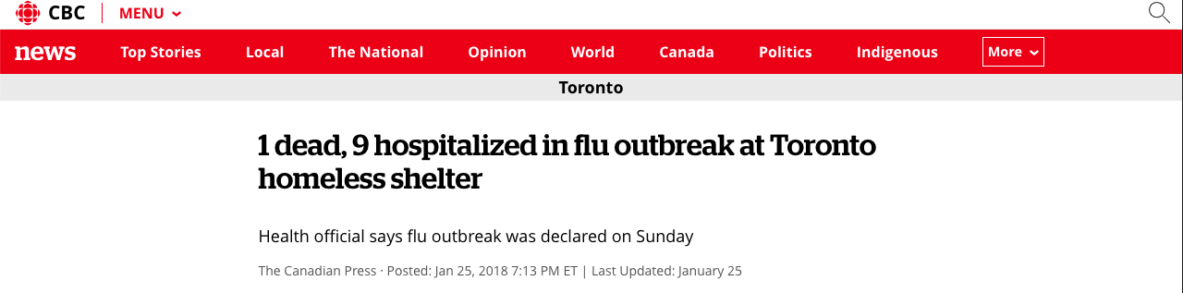
FluES in the Nues

Slide 9
Method:
Orientation/Pre-Processing
Clean the dataset
Orientation
Decide on your question/predictor
Modeling
Split your data into X and y
Split the dataset into train and test sets
Train, test, score the data on a baseline model
Train the train data set on an algorithm/model (or many)
Test and score the train dataset on your model
Tweak model as necessary
91%
9%
Time spent coding vs time spent modeling

Slide 10
Motivation:
“Let’s make a cool topographical graph like they use in avatar!”
Question: if “hospital a” reports a flu outbreak, what is the likelihood that “sunnybrook hospital” will report the same outbreak in the next week?

Slide 11
Cool, Gabs…but I don’t see how that’s a valuable question to explore..

Slide 12
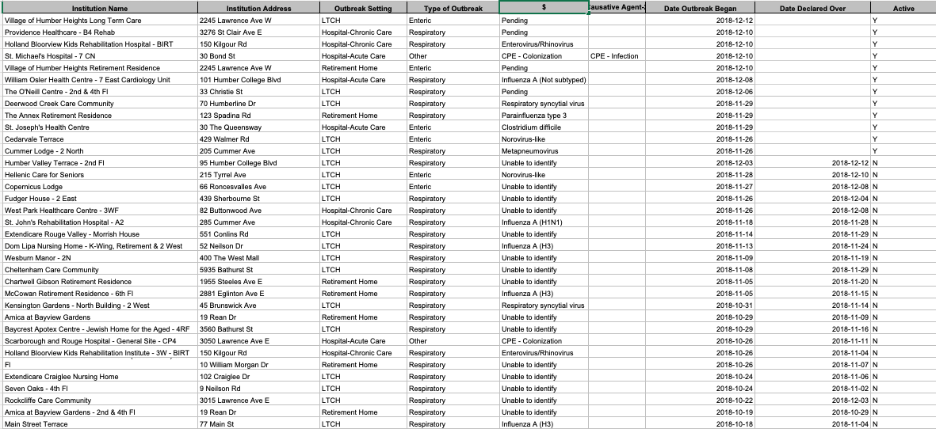
Application:
Orientation/Preprocessing:
Orientation

Slide 13
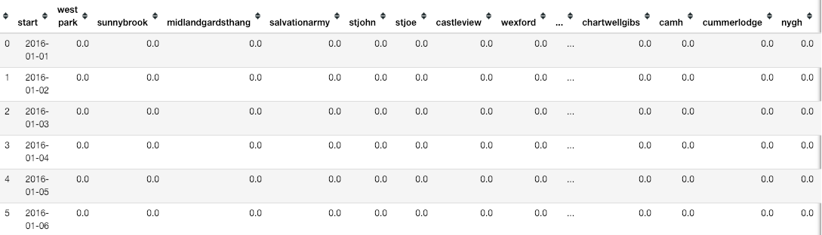
Application:
Orientation/Preprocessing:
Orientation

Slide 14
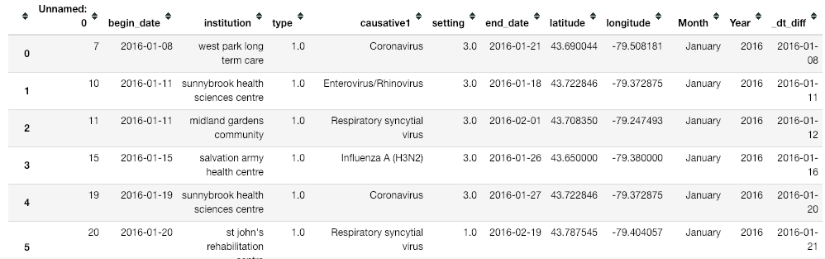
Application:
Orientation/Preprocessing:
Orientation

Slide 15
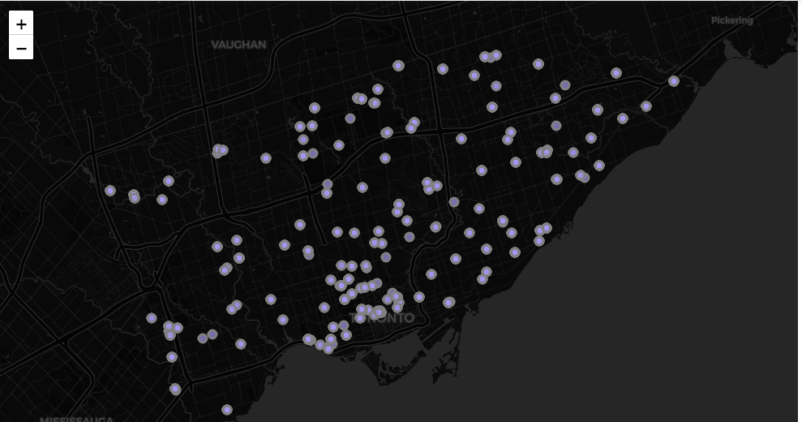
SHOW ME THE INSIGHTS!
All of Toronto’s Recorded Hospitals and LTC homes as of 2018

Slide 16
Do the clicky Thing!
Outbreak Distribution

Slide 17
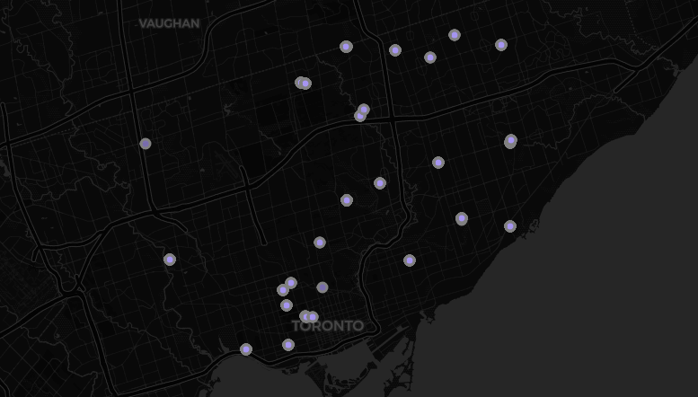
SHOW ME THE INSIGHTS!
Top 23 Hospitals/LTC homes in flu incidence numbers

Slide 18
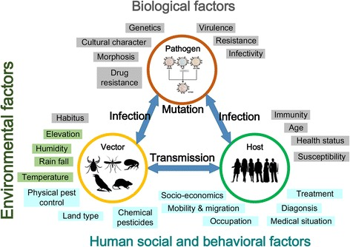
Why are outbreak predictors’ accuracies so low?

Slide 19
Modeling
Split your data into X and y
Split the dataset into train and test sets
Train, test, score the data on a baseline model
Train the train data set on an algorithm/model (or many)
Test and score the train dataset on your model
Tweak model as necessary
Input=(hospital with outbreak, date of their outbreak)
Output=(probability that outbreak will occur at Sunnybrook Hospital)

Slide 20
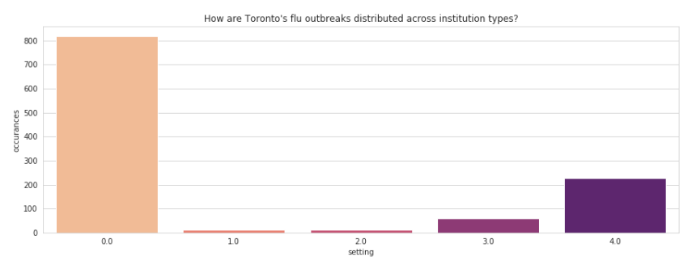
SHOW ME THE INSIGHTS!

Slide 21
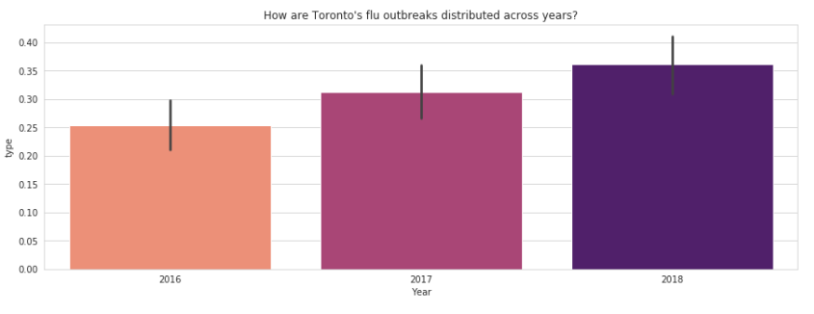
Keep Em COMIN’!

Slide 22
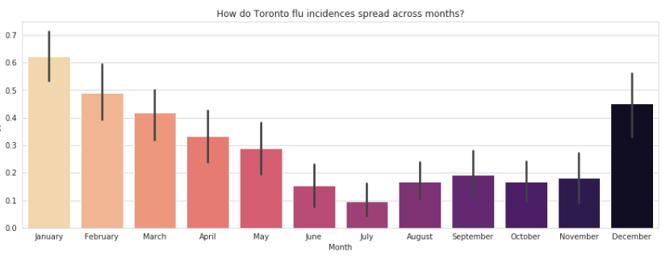
Okay THiS IS enough.

Slide 23
OR IS IT!?

Slide 24
Next Steps
More with this dataset
  Add weather correlations
  Explore how flus move across nursing homes and hospitals
More data!
  Record and release biosurveillance data to predict outbreaks before they occur to stay ahead of the curve

Slide 25
Further Exploration:
http://aime.life/
https://toolbox.google.com/datasetsearch
https://www.drivendata.org/competitions/44/dengai-predicting-disease-spread/

Slide 26
LEssons
Code as much as possible.
Keep in mind that the immersive nature of these programs is a proven aspect of its success..ie. seek out external immersive opportunities if allowed.
Enjoy it. ☺

